Slide 1
Earned Income Credit (EIC)
Pub 4012 Tab I
Pub 17 Chapter 36
(Federal 1040-Line 66a)
(NJ 1040-Line 51a)
Notes:
1

Slide 2
TS – Earned Income Tax Credit – 1040 Line 66a
Notes:
2

Slide 3
Other Considerations
For EIC, support is not an issue
Under rules for divorced/separated parents, only custodial parent qualifies for EIC, no matter who claims dependent
If a nondependent can be claimed as a qualifying child for EIC:
Name of nondependent will not be listed in Exemption section of Federal 1040, but will be listed on Schedule EIC
Name of nondependent will be listed in Dependent section of NJ 1040, followed by (EIC ONLY)
Needed for NJ to verify amount of NJ Earned Income Tax Credit
Notes:
03Filing Status 2008x
3
In TaxWise, we had to manually enter a nondependent who is eligible for NJ EITC using override capability. TaxSlayer automatically lists the nondependent in the Dependent section of the NJ 1040, followed by the words “EIC ONLY”
This helps NJ know how many qualifying children there are for EITC. They can then verify the correct EITC amount

Slide 4
TS – Nondependent Who Is Qualified Child For Earned Income Credit – 1040 Exemption Section
Does not include name of second child who is a nondependent, but is
a qualified child for Earned Income Credit
Notes:
4

Slide 5
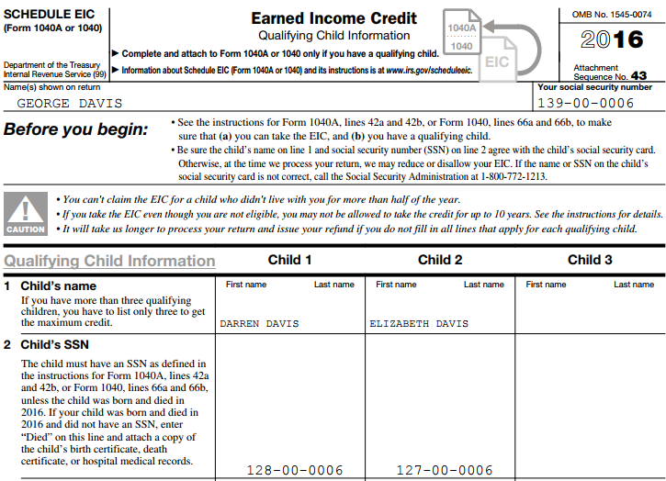
TS – Nondependent Who Is Qualified Child For Earned Income Credit – Schedule EIC
Includes name of second child who is a nondependent, but is
a qualified child for Earned Income Credit
Notes:
5

Slide 6
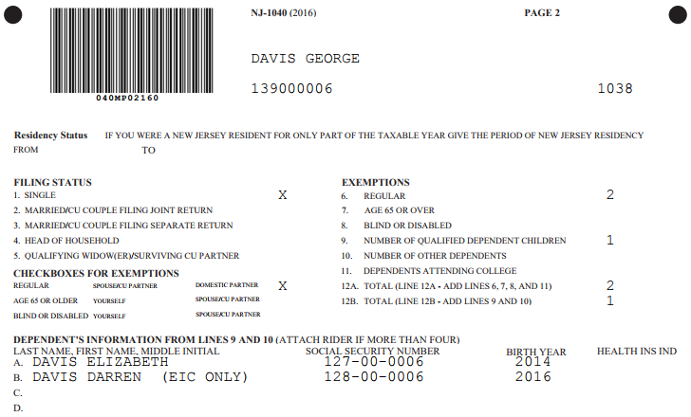
TS – Nondependent Who Is Qualified Child For Earned Income Credit – NJ 1040 Dependent Section
For a nondependent who is a qualified child for Earned Income Credit,
NJ Dependent Section shows name of child followed by ”(EIC ONLY)”
Notes:
6

Slide 7
NJ Earned Income Tax Credit (EITC)
Residents who are eligible & file for Federal EIC may also apply for a NJ EITC
Client may have Federal earned income, but no NJ earned income (e.g. – disability, third-party sick pay). Still eligible for NJ EITC
NJ EITC = 35% of Federal EIC
TaxSlayer calculates automatically on NJ 1040 Line 51a
Before issuing refund checks, NJ checking EITC claims carefully to reduce fraud

Slide 8
NJ Earned Income Tax Credit (EITC) Fraud Detection Measures
NJ checks EITC claims carefully. Frequently sends out requests for additional info
Federal tax account transcript – includes original Federal return, amended return, other IRS letters
SS cards for taxpayer and dependents - to track across years and geography
Birth certificate/guardianship documents for kids
May definitely delay refunds
Also sends out requests to explain differences between Federal and NJ pension amounts
Military pensions, 3-year rule, etc.

Slide 9
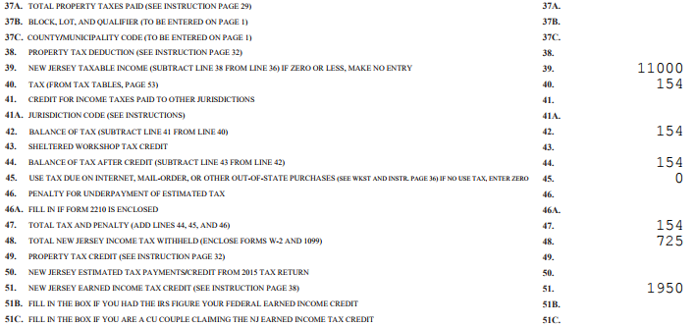
TS – Earned Income Tax Credit - NJ 1040 Line 51
Notes:
9

